Slide 1
State Innovations in Medicaid Managed Long-Term Services and Supports (MLTSS)
NASHP Webinar
March 31st, 2026

Slide 2

Thank You Acknowledgements

Slide 3
Speakers & Agenda
Welcome and Introductory Remarks
  Wendy Fox-Grage, Senior Director, National Academy for State Health Policy (NASHP)
Overview of MLTSS Innovations
  Sarah Barth, Consultant and Subject Matter Expert
State Spotlight #1: Texas
  Jimmy Blanton, Deputy Director, Quality and Program Improvement, Medicaid and CHIP Services, Texas Health and Human Services
State Spotlight #2: Virginia
  Jason Rachel, Director, Division of Integrated Care, Virginia Department of Medical Assistance Services
  Jeannette Abelson, Manager, Care Management Unit, Virginia Department of Medical Assistance Services
Facilitated Q&A

Slide 4

Webinar Logistics
Use the Q&A function at the bottom of your screen to enter your questions and comments throughout the presentations
We will address questions and comments at the end
The close captioning button is located at the bottom of your screen
The slides and webinar recording will be posted after the webinar on the NASHP website and sent out to all webinar registrants

Slide 5
MLTSS Strategies and Innovations –NASHP Paper and Conversations

Slide 6
MLTSS Innovation Areas Spotlighted
  Care Coordination
    Reaching and engaging members
    Workforce shortages and care coordinator turnover
  Managed Care Organization Contract Management
    Prescriptive versus less prescriptive language
    Readiness review frequency
    Staff oversight structures
    Plan accountability approaches and tools
  Member Engagement
    Identify and partner with community and other “champions”
    Meet people where they are
    Create permanent ongoing communication channels
    Provide information back (“close the loop”) to members on feedback acted on

Slide 7
MLTSS State Innovation Examples
  Care Coordination
    California – Enhanced Care Management
    Minnesota – Care Plan Audits
    Virginia – Care Management Extenders
  Managed Care Organization Contract Management
    California – Internal and External Dashboards
    Massachusetts – Contract Management Tracker
    Virginia – Creation of Office of MCO Compliance and Monitoring
  Member Engagement
    California – Medicare and Medi-Cal Ombudsperson Program
    Massachusetts – One Care Implementation Council
    Indiana – Multi-Pronged Strategy

Slide 8
MLTSS State Innovations – Some Top-of-Mind Areas
  Use/Role of technology and artificial intelligence (AI)
  Identification of care coordination best practices - how to measure it
  Sustaining programs
  Health plan partnerships and relationships
  Prevention and identification of fraud, waste and abuse in MLTSS programs

Slide 9
Texas STAR+PLUS: Background
National Academy of State Health Policy
State MLTSS Strategies and Innovations
March 31, 2026

Slide 10
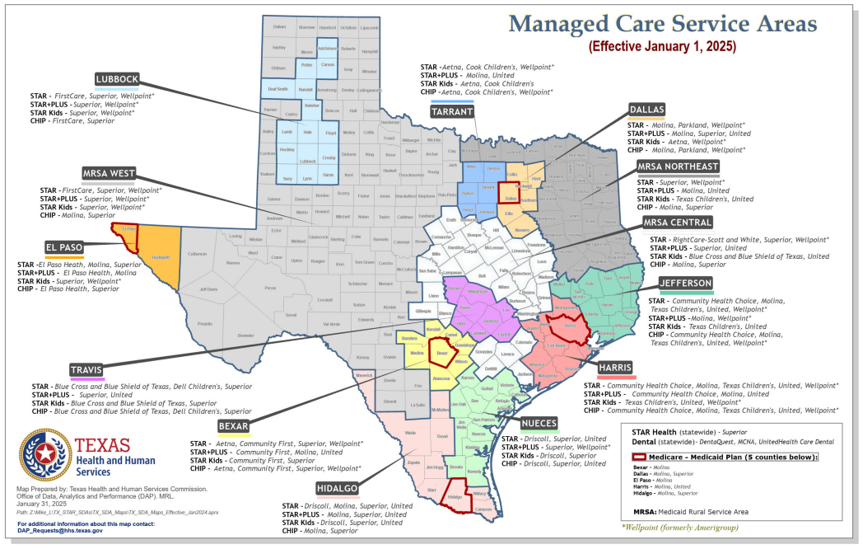
Managed Care Programs, Texas Medicaid
10

Slide 11
STAR+PLUS
Statewide managed care program primarily serving adults with disabilities and those age 65 and older.
Who gets STAR+PLUS?
People with disabilities age 21 years and older
Adults age 65 years and older
Women enrolled in the Medicaid Breast and Cervical Cancer Program
People with IDD who live in a community-based ICF-IID (acute care services only)
People enrolled in a Texas Medicaid IDD waiver (acute care services only)
STAR+PLUS Benefits
Acute care
Behavioral Health
Vision
LTSS (e.g., attendant care, Day Activity and Health Services (DAHS), nursing facility services)
Durable medical equipment
Unlimited prescriptions
STAR+PLUS Home and Community-Based Services (HCBS), if eligible

Slide 12
STAR+PLUS Home and Community-Based Services (HCBS)
Community-based LTSS program for Medicaid eligible adults. Operates as a 1915(c) waiver under the authority of the Texas Healthcare Transformation and Quality Improvement Program.
Who gets SP HCBS?
Adults age 21 and older
Members enrolled in STAR+PLUS
Meets nursing facility level of care
Service plans must be within specified cost limits
SP HCBS Benefits
Adult Foster Care
Assisted Living
Emergency Response
Home-Delivered Meals
Respite
In-Home Nursing
Dental
Transition Assistance

Slide 13
Service Coordination
Specialized care service provided by MCO nurses and other professionals with necessary skills, to coordinate care.
Identify needs
Develop service plan
Coordinate Access
Address unique needs
Coordinate non-capitated services
Member

Slide 14
STAR+PLUS Expansion: Formative Milestones
Year | Milestone
1998 | STAR+PLUS pilot launched in Harris County (acute care + some community LTSS)
Early 2000s | Incremental regional expansions of STAR+PLUS
2014 | STAR+PLUS expands statewide
2014 | STAR+PLUS HCBS waiver implemented statewide
2015 | Nursing facility services carved into STAR+PLUS
2015 | Community First Choice implemented (state plan LTSS expansion)

Slide 15
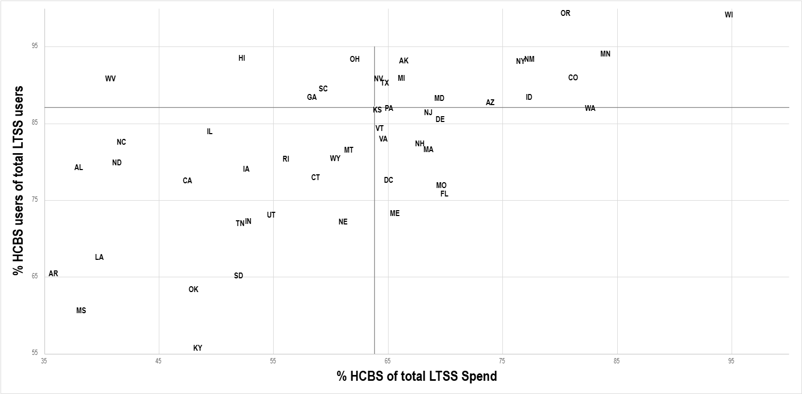
CMS LTSS Rebalancing Indicators, 2023

Slide 16
Thank You
Jimmy Blanton, Deputy Director
Quality & Program Improvement, Medicaid and CHIP Services Division

Slide 17
Cardinal Care Model of Care and Oversight Innovations
Jeannette Abelson, LCSW
Manager, Care Manager Unit
Jason A. Rachel, Ph.D.
Division Director, Integrated Care

Slide 18




Responsive Model of Care
Member-Centered, data-driven model, based on health-related needs/risks
Member Focused
Provides access to care management
services across populations, based on the member’s evolving needs and health risk
Uses data effectively to target appropriate and timely
interventions to drive the right care at the right time
Drives improved health outcomes, as demonstrated by quality measures and clinical efficiencies

Slide 19
Overview of the Cardinal Care Model of Care Design
Key Features of the Model of Care
Includes priority populations from Acute and MLTSS
Leverages MCOs advanced analytics and methods to target data-informed solutions for identifying and stratifying populations by member need/level of risk.
Allocates care management resources equitably across populations based on the member’s need and risk level, with special attention to the Commonwealth’s most vulnerable populations (such as vent-dependent populations)
Supports right care, right place, right time
Maximizes use of limited care management resources
  Assigns elements of care coordination (MMHS, HRA, ICP/ICT, etc.) as appropriate by need and risk level
  Makes ICT meetings required only on an as-needed basis (at a Member’s or Care Manager’s discretion) for members in low and moderate intensity care management
  Considers movement of members between risk and intensity levels, especially based on health related, triggering events as a member’s needs evolve over time
  Allows MCOs the flexibility to use an abbreviated HRA in response to triggering events or interim contacts
  Allows MCOs the flexibility to use telephone or video conference to administer the MMHS, HRA and develop the ICP. The MCO is, however, required to conduct the HRA in-person for Members in High Intensity CM
  Provides flexibility to not require the assigned care manager to do the HRA for in-person visits (except for vent dependent members)
Broadens staffing qualifications for most Care Managers to include a range of social worker and mental health professional designations (to include LMHPs, RN/LPNs, QMHPs, LMSWs, LBSWs, MSWs or BSWs, as appropriate); continues to allow bachelors in health and human services
Links with quality outcomes and clinical efficiencies

Slide 20
Cardinal Care Model of Care Design
The model includes four levels of increasing intensity:
care coordination for those with minimal needs and three levels of care management intensity (low, moderate, and high).
Care Management:
Populations of Focus: Priority populations according to DMAS and MCOs*
Key Activities: Developing comprehensive and centralized care plan, managing physical/behavioral/Rx needs, making timely and necessary referrals, monitoring SDOH needs, implementing and leading interdisciplinary care team, etc.
1
Care Coordination:
Populations of Focus: Individuals not identified as a priority population or otherwise requiring care management.
Key Activities: Initial screening; assessing and coordinating access to needed services (e.g., making referrals); identifying individuals who require Care Management, as needed*; lower staffing requirements; responsive to requests for assistance.
If the care coordinator determines that a full HRA and ICP are warranted, member would move to care management at appropriate intensity level.
Low Intensity
Moderate Intensity
High Intensity
2
3
4
Timelines, contact frequency, staffing ratios increase based on level of intensity assigned
MCOs must assign DMAS mandatory “priority populations” into care management.
MCOs must also identify and assign other individuals who should receive care management even if they do not fit into the priority populations but have increased levels of needs and risk.
Members with acute/episodic conditions would transition from care management to care coordination when the MCO determines care management is no longer needed.
Supports transitions between levels of care and administrative transitions:
Supports transitions between clinical settings and the community, such as hospital discharges, nursing facility transitions, foster care transitions, etc.
Minimizes disruptions during transitions between MCOs/FFS/Medicaid eligibility or due to provider contract termination.

Slide 21
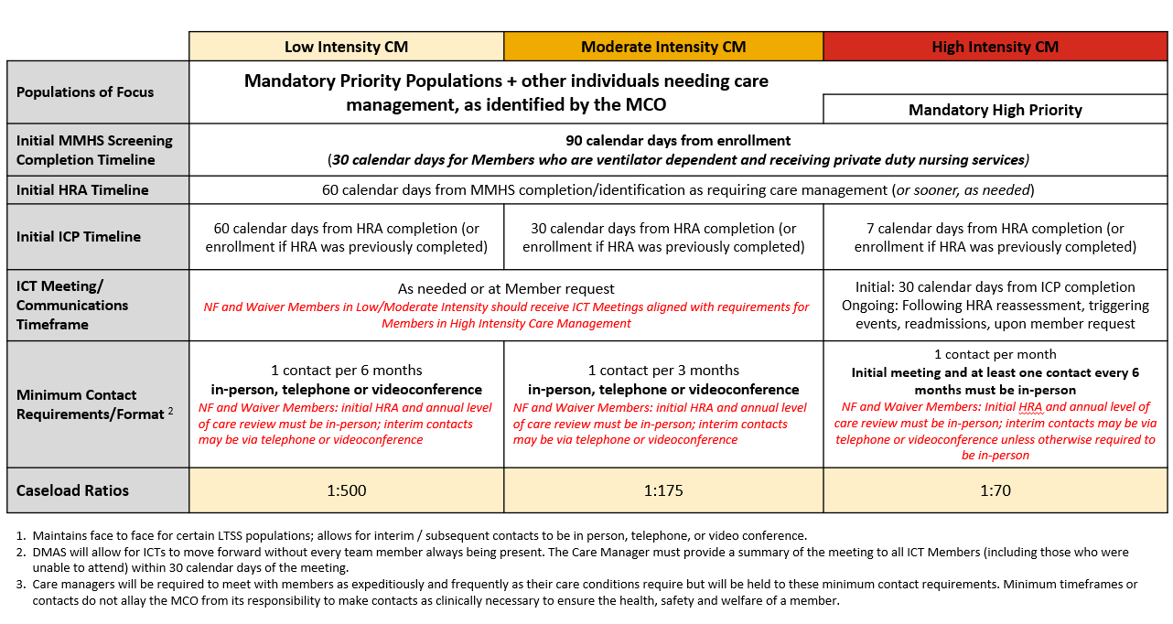
Overview of Care Management requirements for Members in Low, Moderate or High Intensity Care Management:

Slide 22
360 Managed Care Performance Review
Structure
  1 meeting per month to discuss 1 MCO
  Results in discussing each MCO twice per year
  After each full round, we evaluate and tweak our process based on feedback from participants
  Represents 12 to 14 different operational and programmatic areas within the agency
  Each area presents recent findings in a concise 8 to 10 minutes concluding with strengths and areas for improvement

Slide 23
360 Managed Care Performance Review
Process
  At conclusion of the meeting, a full comprehensive report is drafted and shared with the MCO
  Meeting is held with MCO and Agency Leadership to review findings and respond to any questions
  MCOs are provided the discretion to respond as they see fit – from acknowledgement to a fully tracked corrective action

Slide 24
Division of Managed Care Compliance and Monitoring
Background
  Historically, managed care was overseen by two separate divisions within the agency, with each division having its own compliance unit.
  Each compliance unit had different processes and structures for monitoring, addressing, issuing and tracking compliance action
Structure and Process
  Compliance staff from each division along with an additional FTE created a new Office of Managed Care Compliance and Monitoring that reports directly to Deputy of Administration
  New office took the most effective structures and processes from each division to create the new compliance office structure

Slide 25
Division of Managed Care Compliance and Monitoring
Highlights
  Maintaining the referral-based compliance action format
  SMEs from across the agency who are involved in monitoring managed care activities submit compliance referrals
  Office of Compliance continued to use the escalation format for compliance from notices of non-compliance through corrective actions, sanctions and liquated damages
  Office of Compliance hosts monthly meeting on all referrals to review and vote on the agreed upon compliance action to be taken
  Office of Compliance monitors MCO activities to resolution
Early findings
  Direct access to executive level management and transparency in compliance actions taken for awareness and reallocation of workload to focus on monitoring corrective action

Slide 26
Questions?
Submit in the Q&A box at the bottom of your screen.

Slide 27
Thank you!

